Slide 1
Module 5
Advanced ML Classification Technique

Slide 2
Ensemble Classifier
1> Ensemble learning is a way of generating various base classifiers from which a new classifier is derived which performs better than any constituent classifier.
2> Ensemble learning helps improv machine learning results by combining several models.
3> production of better predictive performance compared to a single model.
4>Basic idea is to learn a set of classifiers (experts) and to allow them to vote.

Slide 3
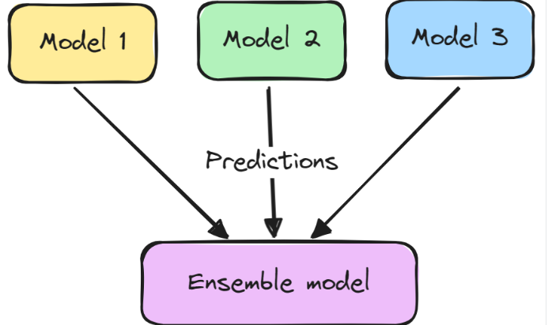
Ensemble Classifier

Slide 4
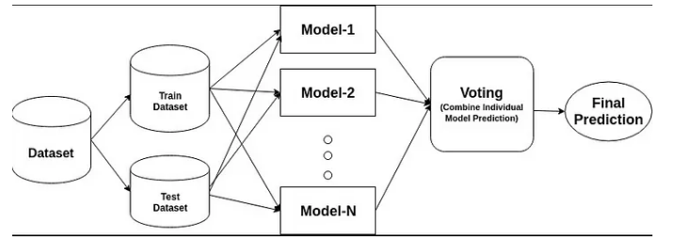
Ensemble Classifier

Slide 5
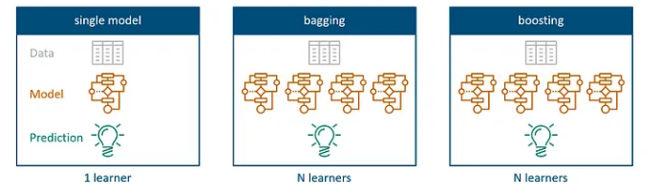
Bagging and Boosting
single models use only one algorithm to create prediction models, bagging and boosting methods aim to combine several of those to achieve better prediction with higher consistency compared to individual learnings.

Slide 6
Bagging
Bagging : is an ensemble method that involves training multiple models independently on random subsets of the data, and aggregating their predictions through voting or averaging.
A base model is created on each of these samplings.
The models run in parallel and are independent of each other.
The final predictions are determined by combining the predictions from all the models.

Slide 7
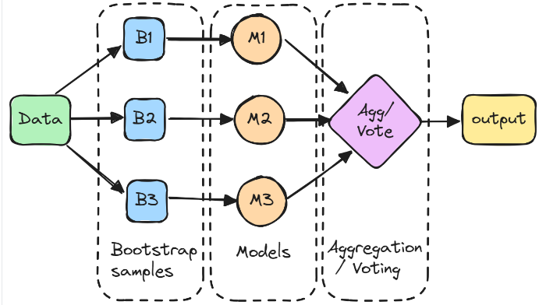
Bagging

Slide 8
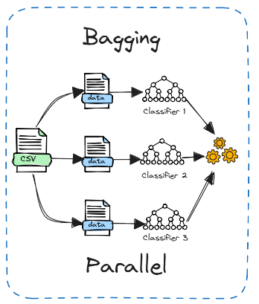
Bagging[2]
1>models are trained independently
in parallel on different random subsets of the
data.
2>effective in reducing variance and overfitting,
making the model more robust and accurate.
3> involves simple averaging of models
4> Bagging can be used with unstable models
like decision trees

Slide 9
Random Forest(collection of decision trees)
1> "Random Forest is a classifier that contains a number of decision trees on various subsets of the given dataset and takes the average to improve the predictive accuracy of that dataset.
ALgo :
Step-1: Select random K data points from the training set.
Step-2: Build the decision trees associated with the selected data points (Subsets).
Step-3: Choose the number N for decision trees that you want to build
Step-4: Repeat Step 1 & 2.
Step-5: For new data points, find the predictions of each decision tree, and assign the new data points to the category that wins the majority votes.

Slide 10
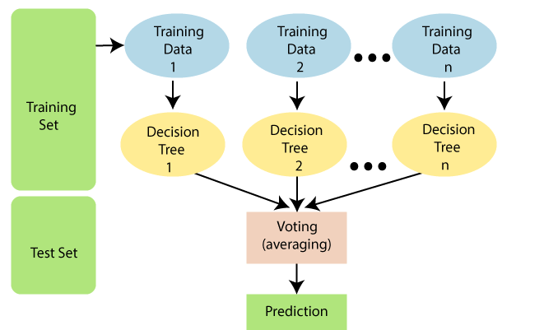
Random Forest(collection of decision trees)

Slide 11
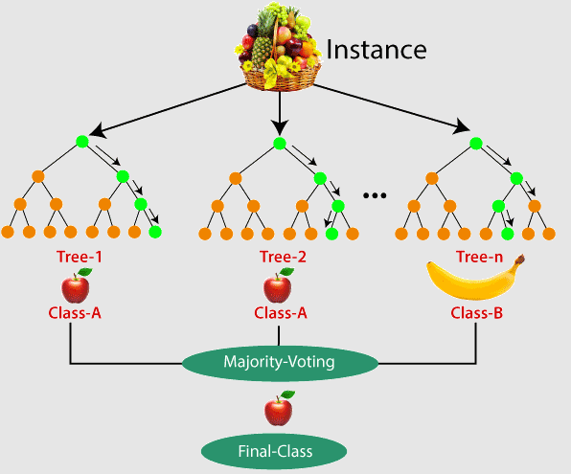
Example:
Suppose there is a dataset that contains
multiple fruit images. So, this dataset is given
to the Random forest classifier. The dataset is
divided into subsets and given to each decision
tree.
During the training phase, each decision
tree produces a prediction result, and when
a new data point occurs, then based on the
majority of results, the Random Forest
classifier predicts the final decision.

Slide 12
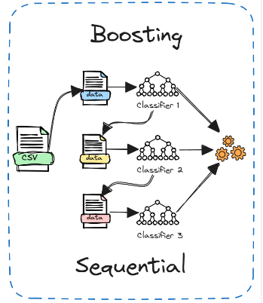
Boosting[1]
1> models are trained sequentially, with each
model learning from the errors of the previous one.
2> boosting works better for stable models like linear
regression.
3> boosting can be more powerful and accurate

Slide 13
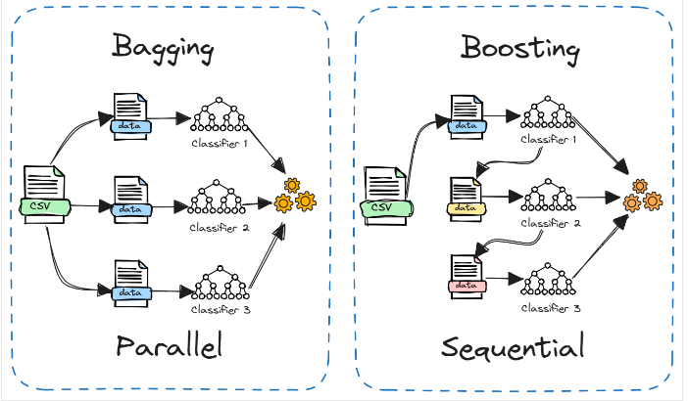
Bagging Vs Boosting

Slide 14
Boosting Algorithm : AdaBoost
1> AdaBoost developed for the purpose of binary classification.
2> combines multiple “weak classifiers” into a single “strong classifier”.

Slide 15
Boosting Algorithm : AdaBoost
Algorithm:
Initialise the dataset and assign equal weight to each of the data point.
Provide this as input to the model and identify the wrongly classified data points.
Increase the weight of the wrongly classified data points and decrease the weights of correctly classified data points. And then normalize the weights of all data points.
if (got required results) Goto step 5 else Goto step 2
End

Slide 16
Confusion Matrix
What is a Confusion Matrix?
Why do we need a Confusion Matrix?
Metrics based on Confusion Matrix Data

Slide 17
Def1: A confusion matrix is a matrix that summarizes the performance of a machine learning model on a set of test data. It is a means of displaying the number of accurate and inaccurate instances based on the model’s predictions
Def2: matrix used to determine the performance of the classification models for a given set of test data.
Def3 : It is a table that is used in classification problems to assess where errors in the model were made.The rows represent the actual classes the outcomes should have been. While the columns represent the predictions we have made.

Slide 18
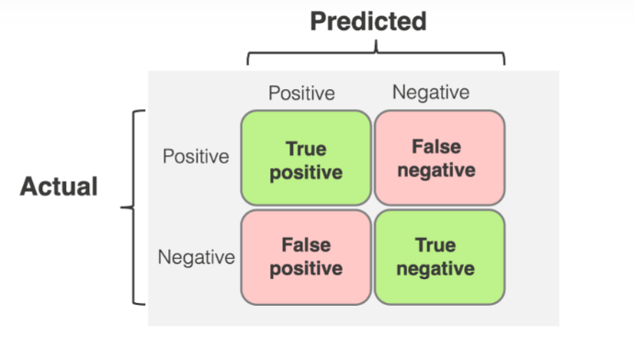
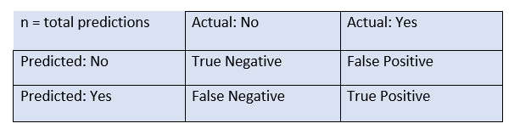
True Positive (TP): The model correctly predicted a positive outcome (the actual outcome was positive).
True Negative (TN): The model correctly predicted a negative outcome (the actual outcome was negative).
False Positive (FP): The model incorrectly predicted a positive outcome (the actual outcome was negative). Also known as a Type I error.
False Negative (FN): The model incorrectly predicted a negative outcome (the actual outcome was positive). Also known as a Type II error.

Slide 19
Why do we need a Confusion Matrix?
1> It offers a thorough analysis of true positive, true negative, false positive, and false negative predictions
2> Enhances model’s recall, accuracy, precision, and overall effectiveness in class distinctintion
3> helpful in evaluating a model’s performance beyond basic accuracy metrics.

Slide 20
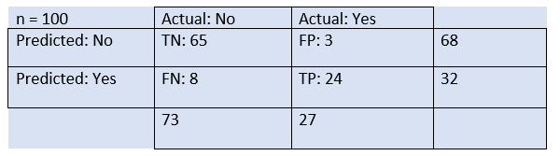
Confusion Matrix Example
The table is given for the two-class classifier, which has two predictions "Yes" and "NO." Here, Yes defines that patient has the disease, and No defines that patient does not has that disease
The classifier has made a total of 100 predictions. Out of 100 predictions, 89 are true predictions, and 11 are incorrect predictions.
The model has given prediction "yes" for 32 times, and "No" for 68 times. Whereas the actual "Yes" was 27, and actual "No" was 73 times.

Slide 21
Calculations using Confusion Matrix:
Classification Accuracy It defines how often the model predicts the correct output.
Accuracy = (True Positive + True Negative) / Total Predictions
2> precision number of correct outputs provided by the model or out of all positive classes that have predicted correctly by the model, how many of them were actually true.
precision = True Positive / (True Positive + False Positive)
3>Sensitivity( Recall : ll:is defined as the out of total positive classes, how our model predicted correctly. The recall must be as high as possible.
Recall = True Positive / (True Positive + False Negative)
4>sensitivity: It measures the ability of a model to correctly identify negative instances. Specificity is also known as the True Negative Rate
sensitivity = True Negative / (True Negative + False Positive)
5> F score : If two models have low precision and high recall or vice versa, it is difficult to compare these models. So, for this purpose, we can use F-score. This score helps us to evaluate the recall and precision at the same time. The F-score is maximum if the recall is equal to the precision
F Score : 2 * ((Precision * Sensitivity) / (Precision + Sensitivity))

Slide 22
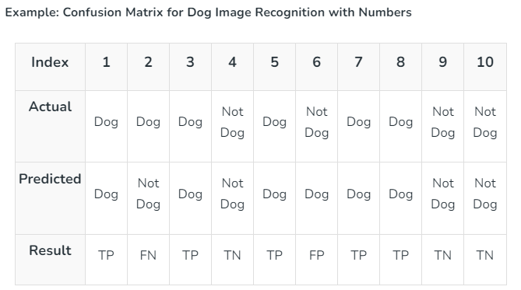
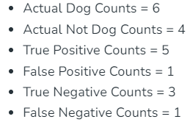
Confusion Matrix For binary classification[2]
A 2X2 Confusion matrix is shown below for the image recognition having a Dog image or Not Dog image

Slide 23
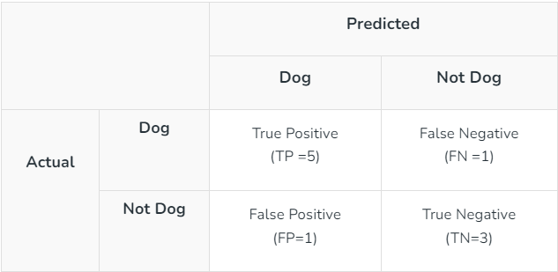
Find the metrics
accuracy
sensitivity
specificity
precision
F score

Slide 25
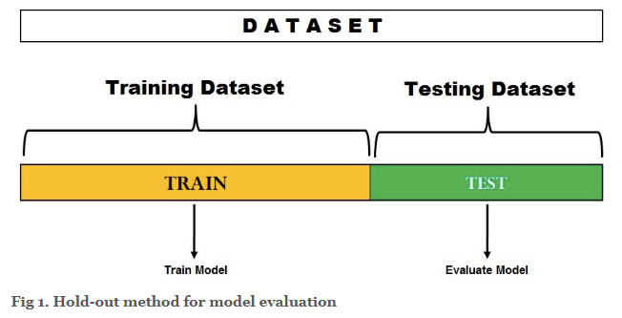
Evaluating Classifier Performance [5]
1> Hold out Method : Holdout Method is the simplest sort of method to evaluate a classifier. In this method, the data set (a collection of data items or examples) is separated into two sets, called the Training set and Test set. 70-30% split is used for splitting the dataset where 70% of the dataset is used for training and 30% dataset is used for testing the model.

Slide 26
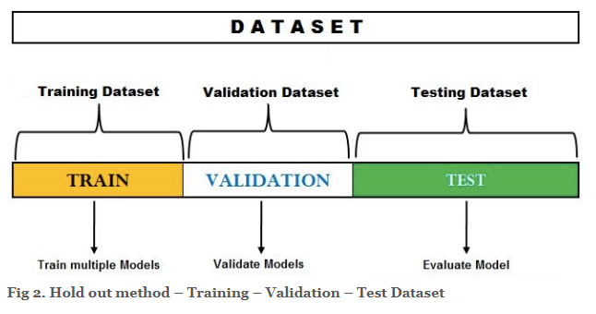

Slide 27
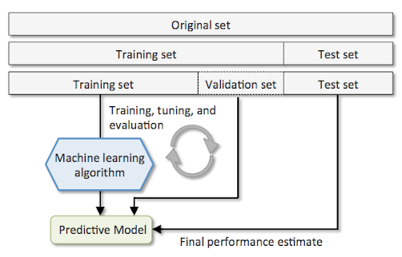

Slide 28
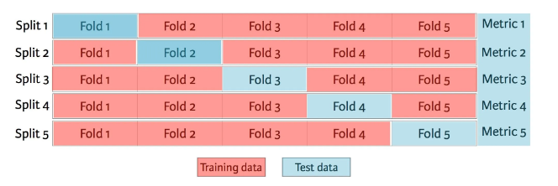
Cross Validation
In Cross-validation or ‘k-fold cross-validation’ the dataset is randomly split up into ‘k’ groups. One of the groups is used as the test set and the rest are used as the training set. The model is trained on the training set and scored on the test set. Then the process is repeated until each unique group as been used as the test set.
5- fold cross validation

Slide 29
Random sampling
Random sampling, or probability sampling, is a sampling method that allows for the randomization of sample selection

Slide 30
ROC Curve and AUC[7]
What is ROC and AUC ?
Why we use the ROC AUC curve ?
How to draw the AUC-ROC curve ?

Slide 31
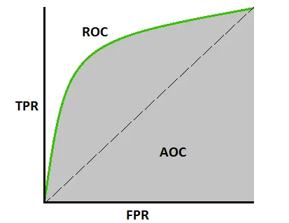
Def : The AUC-ROC curve, or Area Under the Receiver Operating Characteristic curve, is a graphical representation of the performance of a binary classification model at various classification thresholds. It is commonly used in machine learning to assess the ability of a model to distinguish between two classes, typically the positive class (e.g., presence of a disease) and the negative class (e.g., absence of a disease).

Slide 32
Comparing Classifier (cost benefit and ROC curve)[8]

Slide 33
Module 6
Trends and applications in Data Science

Slide 34
Data Science : -
1> study of data to extract meaningful insights for business.
2>multidisciplinary approach that combines principles and practices from the fields of mathematics, statistics, artificial intelligence, and computer engineering to analyze large amounts of data.

Slide 35
Applications of Data Science
Healthcare
Gaming
Recommendation system
Finance
Ecommerce
Cyber security
Logistics
Augmented reality
Autocomplete

Slide 36
Multimodal Applications of Data Science
Modality refers to the way something happens
A multimodal model is a ML/DS model that is capable of processing information from different modalities, including images, audio,videos, and text.
Example :-
1> Facebook
2> linked inn
3> Spotify
4> Instagram
5> Whatsapp etc…

Slide 37
References
1>https://www.datacamp.com/tutorial/what-bagging-in-machine-learning-a-guide-with-examples
2>https://www.geeksforgeeks.org/confusion-matrix-machine-learning/
3>https://www.evidentlyai.com/classification-metrics/confusion-matrix
4> https://www.geeksforgeeks.org/introduction-of-holdout-method/
5>https://vitalflux.com/hold-out-method-for-training-machine-learning-model/

Slide 38
References
6>https://www.evidentlyai.com/classification-metrics/confusion-matrix
7> https://www.geeksforgeeks.org/auc-roc-curve/
8>https://machinelearningmastery.com/assessing-comparing-classifier-performance-roc-curves-2/

